Slide 1
Web Accessibility
SlideMake.com

Slide 2
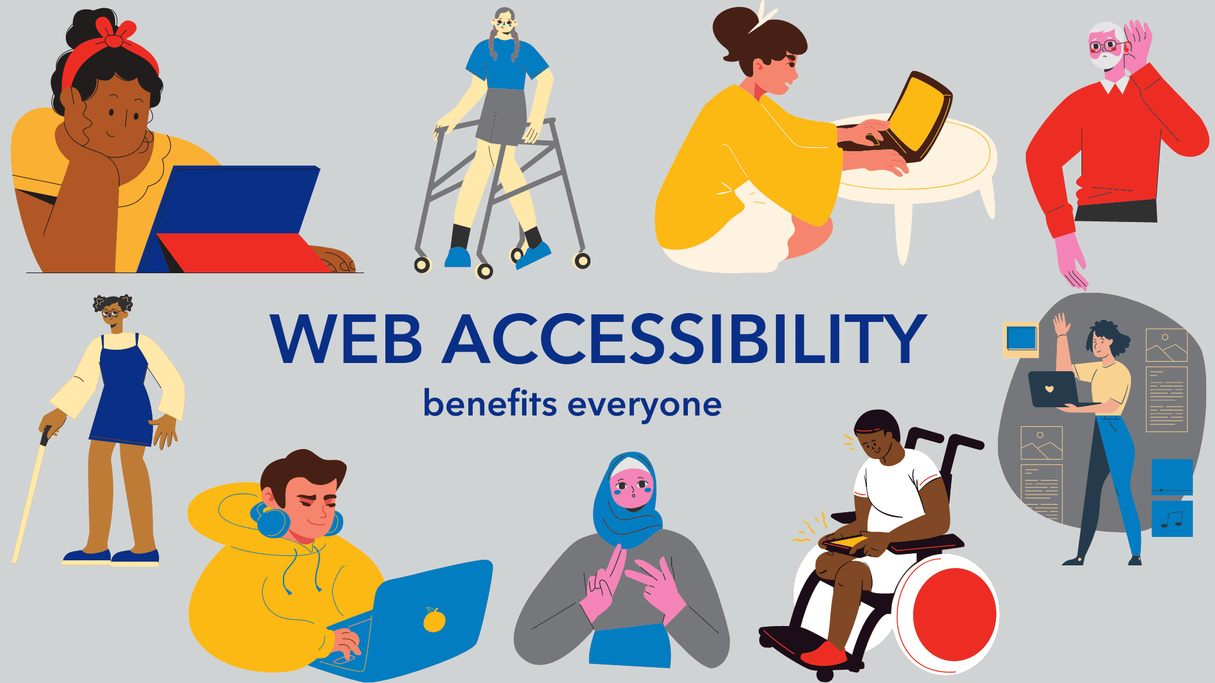
Introduction to Web Accessibility
Web accessibility refers to the inclusive practice of making websites usable for all people, regardless of their abilities or disabilities.
It is essential to ensure that individuals with visual, auditory, motor, or cognitive impairments can access digital content.
The goal is to create a barrier-free online environment that allows everyone to participate fully in the digital world.
1
Notes:
Image source: https://epicassist.org/digital-accessibility-benefits-everyone/

Slide 3
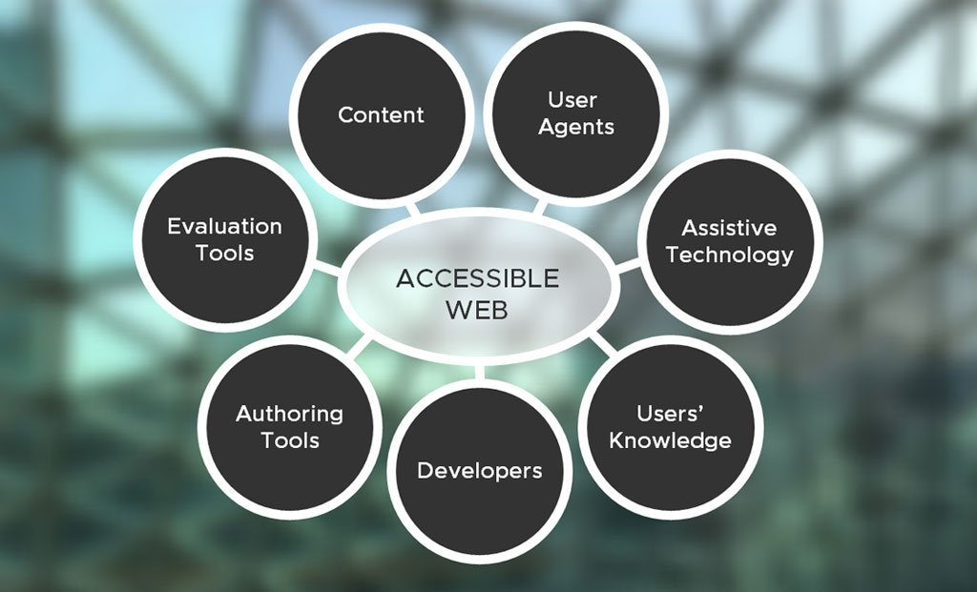
Importance of Web Accessibility
Accessible websites improve user experience for everyone, not just those with disabilities.
It can increase the audience reach and boost engagement for businesses and organizations.
Accessibility is often required by law in many countries, making it a crucial aspect of web development.
2
Notes:
Image source: https://www.corporatecomm.com/blog/what-is-website-accessibility

Slide 4
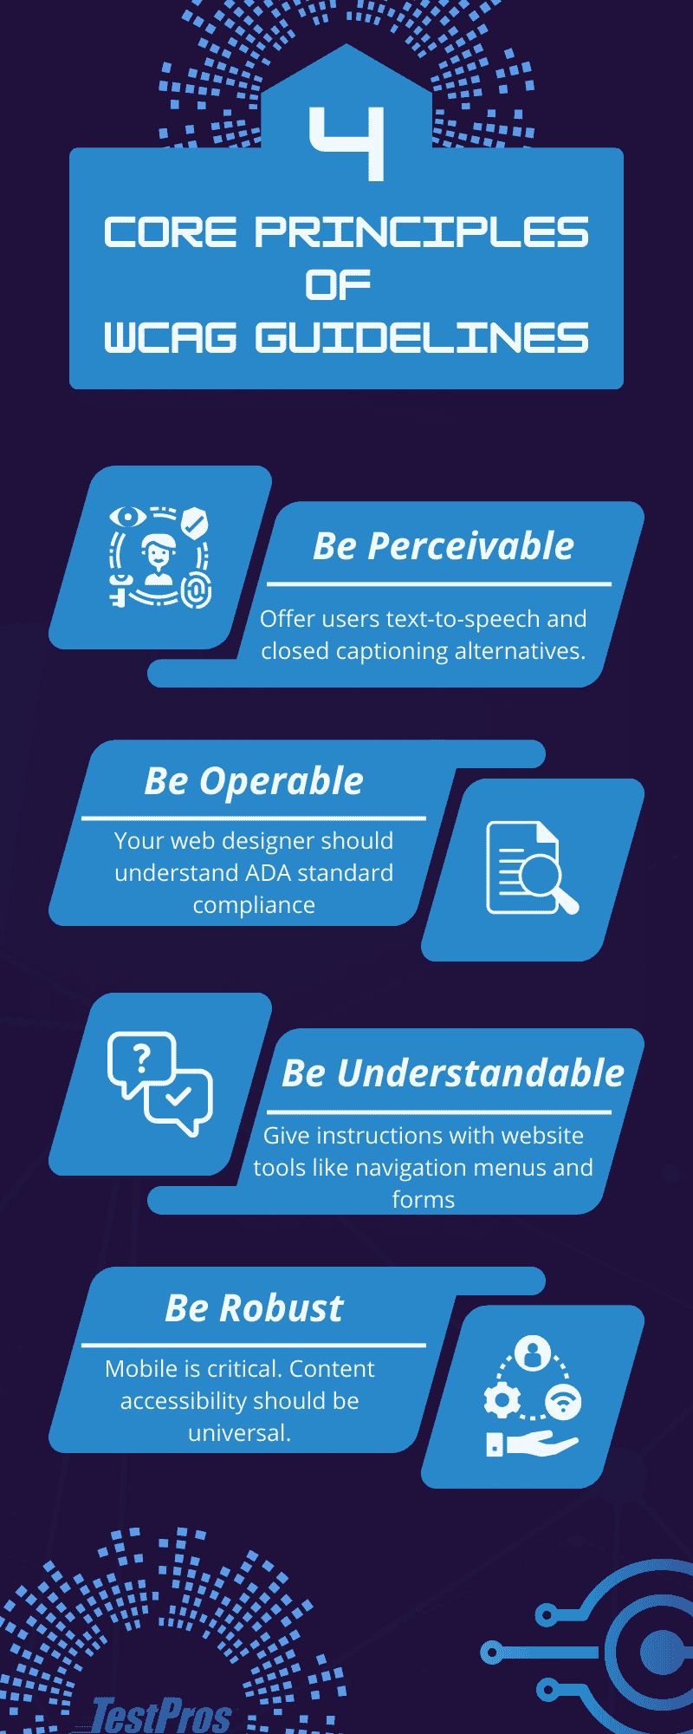
Legal Frameworks and Guidelines
The Web Content Accessibility Guidelines (WCAG) provide a foundation for web accessibility standards.
In the U.S., the Americans with Disabilities Act (ADA) mandates accessibility for public accommodations, including websites.
Other countries have similar legislation, emphasizing the importance of adhering to accessibility standards globally.
3
Notes:
Image source: https://testpros.com/accessibility/wcag-audit/

Slide 5
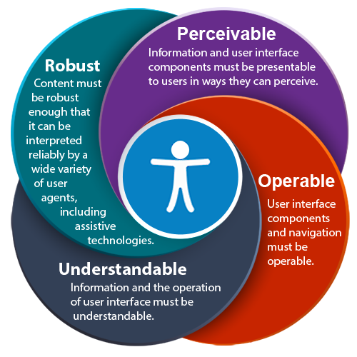
Key Principles of WCAG
The four key principles of WCAG are Perceivable, Operable, Understandable, and Robust.
Each principle serves as a guideline for creating accessible content and functionality across all digital platforms.
Following these principles helps ensure that all users can perceive, interact with, and understand the information presented.
4
Notes:
Image source: https://itss.d.umn.edu/articles/wcag-principles

Slide 6
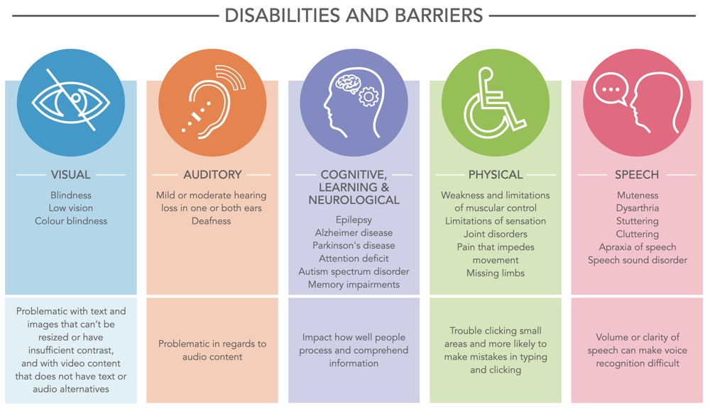
Common Accessibility Barriers
Visual impairments may prevent users from perceiving images, colors, or text without assistive technology.
Auditory impairments can hinder the ability to access audio content, making captions and transcripts essential.
Cognitive disabilities might affect how users navigate websites, emphasizing the need for clear and simple design.
5
Notes:
Image source: https://www.xperienz.pt/articles/creating-accessible-digital-experiences

Slide 7
Design Considerations for Accessibility
Use adequate color contrast to ensure text is readable against background colors.
Provide descriptive alt text for images to convey essential information to screen reader users.
Ensure that interactive elements, like buttons and forms, are easily navigable using a keyboard.
6
Notes:
Image source: https://teaching.pitt.edu/resources/accessibility-color-contrast/

Slide 8
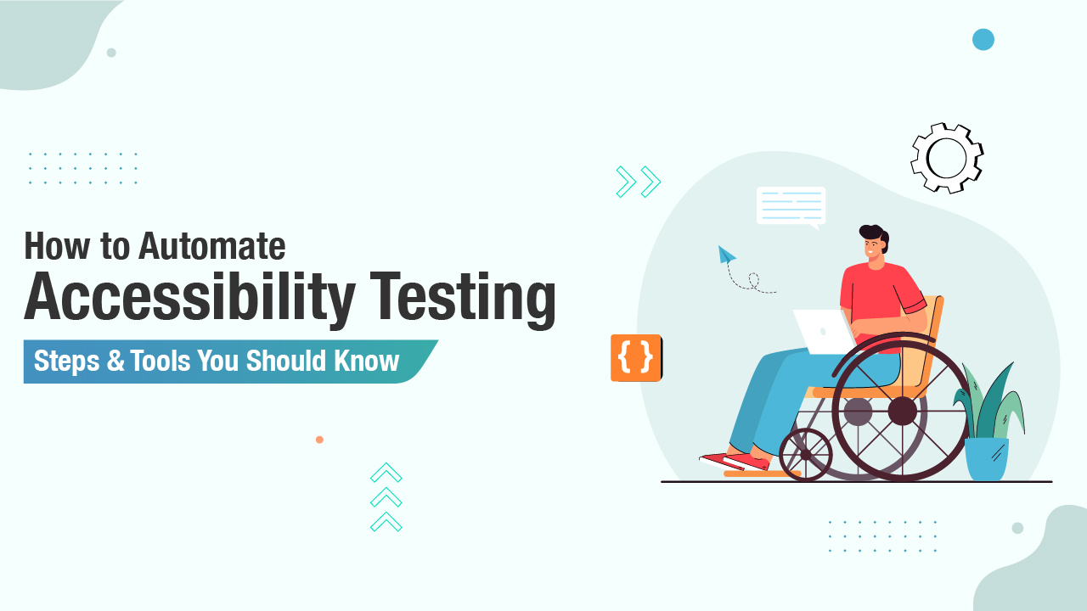
Testing for Accessibility
Regular testing with both automated tools and human evaluation is vital for assessing accessibility.
User testing with individuals who have disabilities can provide valuable insights into real-world usability.
Keeping up with updates in accessibility tools and guidelines is essential for ongoing compliance and improvement.
7
Notes:
Image source: https://testsigma.com/blog/automating-accessibility-testing/

Slide 9

Assistive Technologies
Screen readers convert text to speech, allowing visually impaired users to interact with content.
Voice recognition software enables users with motor impairments to control devices and navigate websites using voice commands.
Other assistive technologies, like alternative input devices, facilitate access for users with various disabilities.
8
Notes:
Image source: https://www.emergentlearningllc.com/assistive-technology-basics-screen-readers/

Slide 10
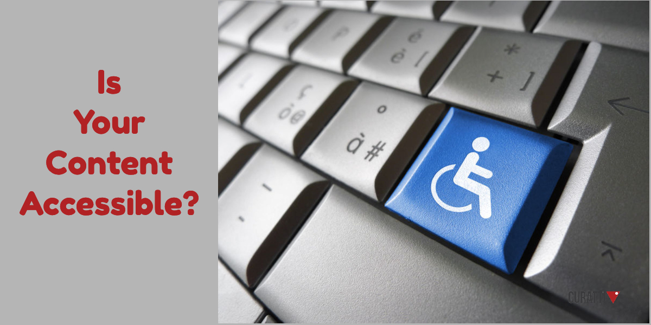
Creating Accessible Content
Ensure all multimedia content is accompanied by captions, transcripts, or audio descriptions for accessibility.
Use clear and simple language to accommodate users with cognitive disabilities and non-native speakers.
Structure content using headings, lists, and tables to improve navigation and comprehension.
9
Notes:
Image source: https://curatti.com/five-steps-to-creating-accessible-content/

Slide 11

The Future of Web Accessibility
As technology evolves, web accessibility will continue to be a critical focus for developers and designers.
Emerging technologies, such as AI and machine learning, have the potential to enhance accessibility features.
Ongoing advocacy and education will be essential to promote inclusive practices in the digital space.
This presentation provides a comprehensive overview of web accessibility, emphasizing its importance, guidelines, and practical considerations for creating accessible websites.
10
Notes:
Image source: https://www.slidemake.com

